Slide 1
Speech coding

Slide 2
What’s the need for speech coding ?
Necessary in order to represent human speech in a digital form
Applications: mobile/telephone communication, voice over IP
Code efficiency (high quality, fewer bits) is a must

Slide 3
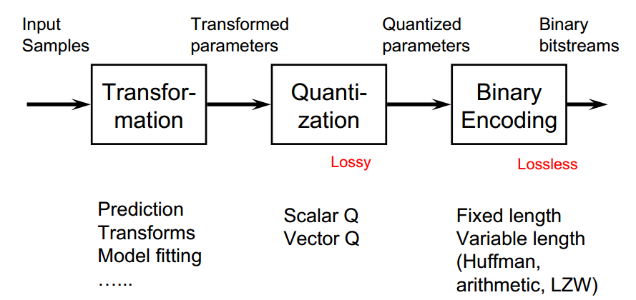
Components of a speech coding system
The sampling process is not depicted in this diagram (it should be on the left side)
“Binary encoding” component is the “Discrete source encoder” from the Digital Communication Principles lecture.

Slide 4
Example of coding techniques
ZIP: no transformation nor quantization, apply VLC (LZW) to the stream of letters (symbols) in a file directly, lossless coding
PCM for speech: no transformation, quantize the speech samples directly, apply fixed length binary coding
ADPCM for speech: apply prediction to original samples, the predictor is adapted from one speech frame to the next, quantize the prediction error, error symbols coded using fixed length binary coding
JPEG for image: apply discrete cosine transform to blocks of image pixels, quantize the transformed coefficients, code the quantized coefficients using variable length coding (runlength + Huffman coding)

Slide 5
Binary encoding

Slide 6
Binary encoding
Binary encoding: to represent a finite set of symbols using binary codewords.
Fixed length coding: N levels represented by (int) log₂(N) bits.
Variable length coding (VLC): more frequently appearing symbols represented by shorter codewords (Huffman, arithmetic, LZW=zip).
The minimum number of bits required to represent a source is bounded by its entropy

Slide 7
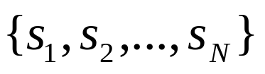
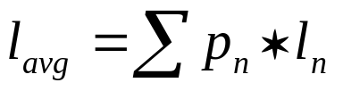
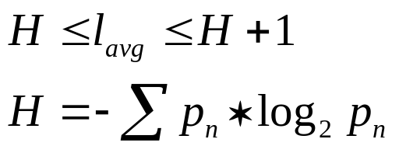
Entropy bound on bitrate (Shannon theory)
A source with finite number of symbols
Symbol s_{n} has probability (frequency) P(s_{n}) = p_{n}
If symbol s_{n} is given a codeword with l_{n} bits, the average bitrate (bits/symbol) would be:
Average bitrate is bounded by the entropy of the source (H):
For this reason, variable length coding is also known as entropy coding

Slide 8
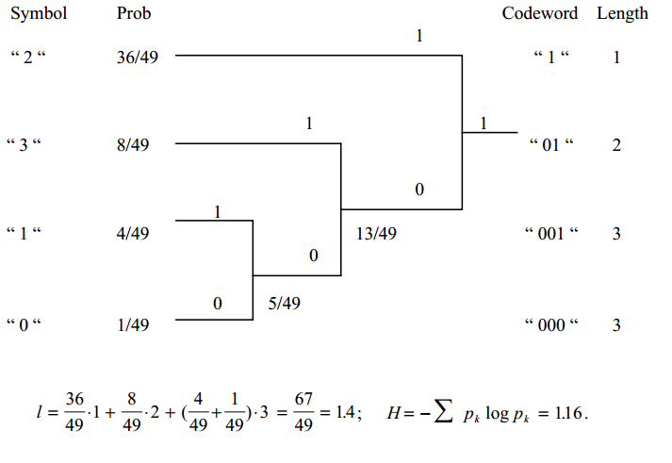
Huffman encoding example

Slide 9
Huffman encoding example (2)
Huffman encode the sequence of symbols {3,2,2,0,1,1,2,3,2,2} using the codes from previous slide
Code table:
Coded sequence: {01,1,1,000,001,001,1,01,1,1}
  Average bit rate: 18 bits/10=1.8 bits/symbol
  Fixed length coding rate: 2 bits/symbol
  Saving is more obvious for a longer sequence of symbol
Decoding: table lookup
Symbol | Codeword
0 | 000
1 | 001
2 | 1
3 | 01

Slide 10
Huffman encoding algorithm
Step 1: arrange the symbol probabilities in a decreasing order and consider them as leaf nodes of a tree
Step 2: while there are more than one node:
  Find the two nodes with the smallest probability and assign the one with the lowest probability a “0”, and the other one a “1” (or the other way, but be consistent)
  Merge the two nodes to form a new node whose probability is the sum of the two merged nodes.
  Go back to Step 1
Step 3: For each symbol, determine its codeword by tracing the assigned bits from the corresponding leaf node to the top of the tree. The bit at the leaf node is the last bit of the codeword

Slide 11
More on Huffman encoding
Huffman coding achieves the upper entropy bound
One can code one symbol at a time (scalar coding) or a group of symbols at a time (vector coding)
If the probability distribution is known and accurate, Huffman coding is very good (off from the entropy by 1 bit at most).

Slide 12
Transformation

Slide 13
Waveform-based coders
Non-predictive coding (uniform or non-uniform): samples are encoded independently; PCM
Predictive coding: samples are encoded as difference from other samples; LCP or Differential PCM (DPCM)

Slide 14
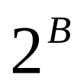
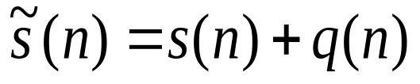
PCM (Pulse Code Modulation)
In PCM each sample of the signal is quantized to one of the amplitude levels, where B is the number of bits used to represent each sample
The bitrate of the encoded signal will be : B*F bps where F is the sample frequency
The quantized waveform is modeled as:
where q(n) is the quantization noise

Slide 15
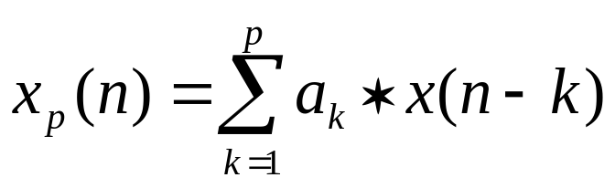
Predictive coding (LPC or DPCM)
Observation: Adjacent samples are often similar
Predictive coding:
  Predict the current sample from previous samples, quantize and code the prediction error, instead of the original sample.
  If the prediction is accurate most of the time, the prediction error is concentrated near zeros and can be coded with fewer bits than the original signal
  Usually a linear predictor is used (linear predictive coding):

Slide 16
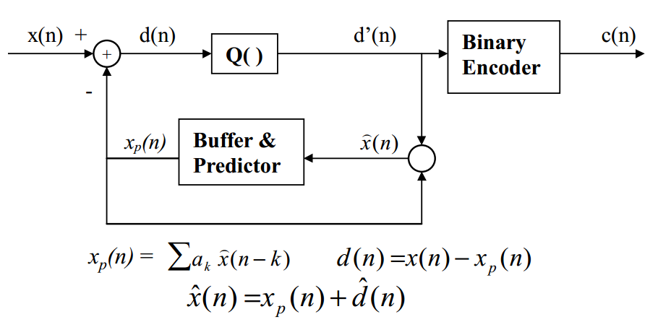
Predictive encoder diagram

Slide 17
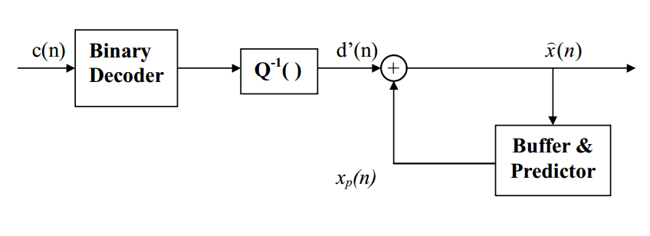
Predictive decoder diagram

Slide 18
Quantization

Slide 19
Uniform quantisation
Each sample of speech x(t) is represented by a binary number x[n].
Each binary number represents a quantisation level.
With uniform quantisation there is constant voltage difference Δ between levels.
111
x(t)
Volts
7Δ
x[n]
6 Δ
110
101
5 Δ
Δ
100
4 Δ
011
3 Δ
010
2 Δ
001
Δ
000
n
T
1
2
3
4
5
6
7
8

Slide 20
Quantisation error
If samples are rounded, uniform quantisation produces
unless overflow occurs when magnitude of e[n] may >> Δ/2.
Overflow is best avoided.
e[n] is quantisation error.

Slide 21

Noise due to uniform quantisation error
Samples e[n] are ‘random’ within ±Δ/2.
If x[n] is converted back to analogue form, these samples are heard as a ‘white noise’ sound added to x(t).
Noise is an unwanted signal.
White noise is spread evenly across all frequencies.
Sounds like a waterfall or the sea.
Not a car or house alarm, or a car revving its engine.
Samples e[n] have uniform probability between ±Δ/2.
It may be shown that the mean square value of e[n] is:
Becomes the power of analogue quantisation noise.
Power in Watts if applied to 1 Ohm speaker. Loudness!!

Slide 22
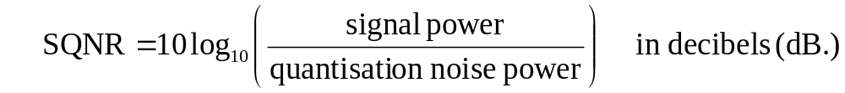
Signal-to-quantisation noise ratio (SQNR)
Measure how seriously signal is degraded by quantisation noise.
With uniform quantisation, quantisation-noise power is Δ²/12
Independent of signal power.
Therefore, SQNR will depend on signal power.
If we amplify signal as much as possible without overflow, for
sinusoidal waveforms with n-bit uniform quantiser:
SQNR ≈ 6n + 1.8 dB.
Approximately true for speech also.

Slide 23
Variation of input levels
For telephone users with loud voices & quiet voices,
quantisation-noise will have same power, Δ²/12.
Δ may be too large for quiet voices, OK for slightly louder ones,
& too small (risking overflow) for much louder voices.
volts
111
Δ
001
Δ
000
Δ too big for quiet voice
OK
Δ too small for loud voice

Slide 24
Companding for ‘narrow-band’ speech
‘Narrow-band’ speech is what we hear over telephones.
Normally band-limited from 300 Hz to about 3500 Hz.
May be sampled at 8 kHz.
8-bits per sample not sufficient for good ‘narrow-band’ speech encoding with uniform quantisation.
Problem lies with setting a suitable quantisation step-size Δ.
One solution is to use instantaneous companding.
Step-size adjusted according to amplitude of sample.
For larger amplitudes, larger step-sizes used as illustrated next.
‘Instantaneous’ because step-size changes from sample to sample.

Slide 25
Non-uniform quantisation used for companding
0111
x[n]
x(t)
0110
0101
0100
0001
t
-001
-101
-110
-111

Slide 26
Implementation of companding
Digitise x(t) accurately with uniform quantisation to give x[n].
Apply compressor formula to x[n] to give y[n].
Uniformly quantise y[n] using fewer bits
Store or transmit the compressed result.
Passing it thro’ expander reverses effect of compressor.
As y[n] was quantised, we don’t get x[n] exactly.
x[n]
y[n]
Uniform
quantise
(many bits)
Uniform quantise (fewer bits)
Transmit
or store
x’[n]
Compressor
Expander
x(t)

Slide 27
Effect of compressor
Increase smaller amplitudes of x[n] & reduce larger ones.
When uniform quantiser is applied, fixed Δ appears:
  smaller in proportion to smaller amplitudes of x[n],
  larger in proportion to larger amplitudes.
Effect is non-uniform quantisation as illustrated before.
Famous compressor formulas: A-law & Mu-law (G711)
These require 8-bits per sample.
Expander is often implemented by a ‘look-up’ table.
You have only 4 - bits per sample – makes the task hard!
There is no unique solution

Slide 28
Speech coding characteristics
Speech coders are lossy coders, i.e. the decoded signal is different from the original
The goal in speech coding is to minimize the distortion at a given bit rate, or minimize the bit rate to reach a given distortion
Metrics in speech coding:
  Objective measure of distortion is SNR (Signal to noise ratio);
SNR does not correlate well with perceived speech quality
  Subjective measure - MOS (mean opinion score):
    5: excellent
    4: good
    3: fair
    2: poor
    1: bad

